Slide 1

Biography
2008~2012
Bachelor Degree, Shandong University
School of Computer Science and Technology
2012~2015
Master Degree, Shandong University
Computer Science, Supervisor: Zhiping Jia
2015~2018
PhD Degree, The HongKong Polythetic University
Computing, Supervisor: Zili Shao
2018~now
Assistant Professor, Shandong University
School of Computer Science and Technology
Shen zhaoyan
(申兆岩)
Research Interest
Embedded System，Big Data Storage
Smart Gateway, IoT Blockchain

Slide 2
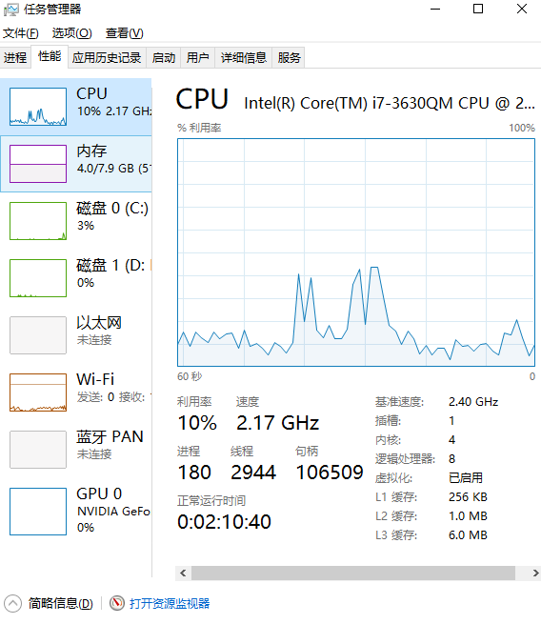

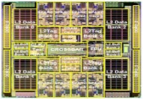


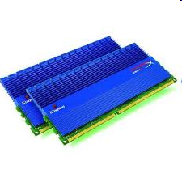
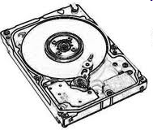
为什么需要新型的非易失性存储器
SRAM
SRAM
缓存
1ns
内存
DRAM
Emerging NVM
30ns
固态硬盘
?
磁盘
云存储
HDD
>10ms
Notes:
Emerging, resistive memory technologies (NVM) can help
Traditional memory
Slow, high cost
Higher energy
Speed gap
New memory technology
Technology scalability:
lower cost, higher capacity,
lower energy
Energy (and power) efficiency
QoS support and configurability (for consolidation)

Slide 3

Chapter 3: CPU
Embedded System Design

Slide 4
Selecting a Microprocessor
Issues
Technical: speed, power, size, cost
Other: development environment, prior expertise, licensing, etc.
Speed: how evaluate a processor’s speed?
Clock speed – but instructions per cycle may differ
Instructions per second – but work per instr. may differ
Dhrystone: Synthetic benchmark, developed in 1984. Dhrystones/sec.
MIPS: 1 MIPS = 1757 Dhrystones per second (based on Digital’s VAX 11/780). A.k.a. Dhrystone MIPS. Commonly used today.
So, 750 MIPS = 750*1757 = 1,317,750 Dhrystones per second
SPEC: set of more realistic benchmarks, but oriented to desktops
EEMBC – EDN Embedded Benchmark Consortium,
Suites of benchmarks: automotive, consumer electronics, networking, office automation, telecommunications

Slide 5
Input and Output
Required to communicate with outside world
PC System:
Keyboard
Monitor
Parallel port (printer port)
Serial port + USB
Embedded System:
Sensors (e.g. in automobile: acceleration sensor, seat sensor)
Actuators (e.g. in automobile: valves for airbags)

Slide 6
Input and Output
Input / output device implementation can be:
• Memory-mapped
• I/O mapped (ports)
• DMA (direct memory access)

Slide 7
Parallel communication
Multiple data, control, and possibly power wires
One bit per wire
High data throughput with short distances
Typically used when connecting devices on same IC or same circuit board
Bus must be kept short
long parallel wires result in high capacitance values which requires more time to charge/discharge
Data misalignment between wires increases as length increases
Higher cost, bulky

Slide 8
Serial communication
Single data wire, possibly also control and power wires
Words transmitted one bit at a time
Higher data throughput with long distances
Less average capacitance, so more bits per unit of time
Cheaper, less bulky
More complex interfacing logic and communication protocol
Sender needs to decompose word into bits
Receiver needs to recompose bits into word
Control signals often sent on same wire as data increasing protocol complexity

Slide 9
Serial Transmission Using UARTs
UART: Universal Asynchronous Receiver Transmitter
Takes parallel data and transmits serially
Receives serial data and converts to parallel
Parity: extra bit for simple error checking
Start bit, stop bit
Baud rate
signal changes per second
bit rate usually higher
embedded device
1
0
1
0
1
0
1
1
1
0
0
1
1
0
1
1
1
0
0
1
1
0
1
1
Sending UART
Receiving UART
start bit
end bit
data

Slide 10
Wireless communication
Infrared (IR)
Electronic wave frequencies just below visible light spectrum
Diode emits infrared light to generate signal
Infrared transistor detects signal, conducts when exposed to infrared light
Cheap to build
Need line of sight, limited range
Radio frequency (RF)
Electromagnetic wave frequencies in radio spectrum
Analog circuitry and antenna needed on both sides of transmission
Line of sight not needed, transmitter power determines range

Slide 11
Error detection and correction
Often part of bus protocol
Error detection: ability of receiver to detect errors during transmission
Error correction: ability of receiver and transmitter to cooperate to correct problem
Typically done by acknowledgement/retransmission protocol
Bit error: single bit is inverted
Burst of bit error: consecutive bits received incorrectly
Parity: extra bit sent with word used for error detection
Odd parity: data word plus parity bit contains odd number of 1’s
Even parity: data word plus parity bit contains even number of 1’s
Always detects single bit errors, but not all burst bit errors
Checksum: extra word sent with data packet of multiple words
e.g., extra word contains XOR sum of all data words in packet

Slide 12
Serial protocols: I²C
I²C (Inter-IC)
Two-wire serial bus protocol developed by Philips Semiconductors nearly 20 years ago
Enables peripheral ICs to communicate using simple communication hardware
Data transfer rates up to 100 kbits/s and 7-bit addressing possible in normal mode
3.4 Mbits/s and 10-bit addressing in fast-mode
Common devices capable of interfacing to I²C bus:
EPROMS, Flash, and some RAM memory, real-time clocks, watchdog timers, and microcontrollers

Slide 13
I2C bus structure
SCL
SDA
Micro-controller
(master)
EEPROM
(servant)
Temp. Sensor
(servant)
LCD-controller
(servant)
< 400 pF
Addr=0x01 Addr=0x02 Addr=0x03
SDA
SDA
SDA
SDA
SCL
SCL
SCL
SCL
Start condition
Sending 0
Sending 1
Stop condition
From Servant
From receiver
D
C
ST
ART
A6
A5
A0
R/w
ACK
D8
D7
D0
ACK
ST
OP
Typical read/write cycle

Slide 14
Serial protocols: CAN
CAN (Controller area network)
Protocol for real-time applications
Developed by Robert Bosch GmbH
Originally for communication among components of cars
Applications now using CAN include:
elevator controllers, copiers, telescopes, production-line control systems, and medical instruments
Data transfer rates up to 1 Mbit/s and 11-bit addressing
Common devices interfacing with CAN:
8051-compatible 8592 processor and standalone CAN controllers
Actual physical design of CAN bus not specified in protocol
Requires devices to transmit/detect dominant and recessive signals to/from bus
e.g., ‘1’ = dominant, ‘0’ = recessive if single data wire used
Bus guarantees dominant signal prevails over recessive signal if asserted simultaneously

Slide 15
Serial protocols: FireWire
FireWire (a.k.a. I-Link, Lynx, IEEE 1394)
High-performance serial bus developed by Apple Computer Inc.
Designed for interfacing independent electronic components
e.g., Desktop, scanner
Data transfer rates from 12.5 to 400 Mbits/s, 64-bit addressing
Plug-and-play capabilities
Packet-based layered design structure
Applications using FireWire include:
disk drives, printers, scanners, cameras
Capable of supporting a LAN similar to Ethernet
64-bit address:
10 bits for network ids, 1023 subnetworks
6 bits for node ids, each subnetwork can have 63 nodes
48 bits for memory address, each node can have 281 terabytes of distinct locations

Slide 16
Serial protocols: USB
USB (Universal Serial Bus)
Easier connection between PC and monitors, printers, digital speakers, modems, scanners, digital cameras, joysticks, multimedia game equipment
2 data rates:
12 Mbps for increased bandwidth devices
1.5 Mbps for lower-speed devices (joysticks, game pads)
Tiered star topology can be used
One USB device (hub) connected to PC
hub can be embedded in devices like monitor, printer, or keyboard or can be standalone
Multiple USB devices can be connected to hub
Up to 127 devices can be connected like this
USB host controller
Manages and controls bandwidth and driver software required by each peripheral
Dynamically allocates power downstream according to devices connected/disconnected

Slide 17
Parallel protocols: PCI Bus
PCI Bus (Peripheral Component Interconnect)
High performance bus originated at Intel in the early 1990’s
Standard adopted by industry and administered by PCISIG (PCI Special Interest Group)
Interconnects chips, expansion boards, processor memory subsystems
Data transfer rates of 127.2 to 508.6 Mbits/s and 32-bit addressing
Later extended to 64-bit while maintaining compatibility with 32-bit schemes
Synchronous bus architecture
Multiplexed data/address lines

Slide 18
Parallel protocols: ARM Bus
ARM Bus
Designed and used internally by ARM Corporation
Interfaces with ARM line of processors
Many IC design companies have own bus protocol
Data transfer rate is a function of clock speed
If clock speed of bus is X, transfer rate = 16 x X bits/s
32-bit addressing

Slide 19
Wireless protocols: IrDA
IrDA
Protocol suite that supports short-range point-to-point infrared data transmission
Created and promoted by the Infrared Data Association (IrDA)
Data transfer rate of 9.6 kbps and 4 Mbps
IrDA hardware deployed in notebook computers, printers, PDAs, digital cameras, public phones, cell phones
Lack of suitable drivers has slowed use by applications
Windows 2000/98 now include support
Becoming available on popular embedded OS’s

Slide 20
Wireless protocols: Bluetooth
Bluetooth
New, global standard for wireless connectivity
Based on low-cost, short-range radio link
Connection established when within 10 meters of each other
No line-of-sight required
e.g., Connect to printer in another room

Slide 21
Wireless Protocols: IEEE 802.11
IEEE 802.11
Proposed standard for wireless LANs
Specifies parameters for PHY and MAC layers of network
PHY layer
physical layer
handles transmission of data between nodes
provisions for data transfer rates of 1 or 2 Mbps
operates in 2.4 to 2.4835 GHz frequency band (RF)
or 300 to 428,000 GHz (IR)
MAC layer
medium access control layer
protocol responsible for maintaining order in shared medium
collision avoidance/detection

Slide 22
Microprocessor interfacing: interrupts
What is the address (interrupt address vector) of the ISR?
Fixed interrupt
Address built into microprocessor, cannot be changed
Either ISR stored at address or a jump to actual ISR stored if not enough bytes available
Vectored interrupt
Peripheral must provide the address
Common when microprocessor has multiple peripherals connected by a system bus
Compromise: interrupt address table

Slide 23
Interrupt-driven I/O using vectored interrupt
1(a): μP is executing its main program.
1(b): P1 receives input data in a register with address 0x8000.
Time
2: P1 asserts Int to request servicing by the microprocessor.
3: After completing instruction at 100, μP sees Int asserted, saves the PC’s value of 100, and asserts Inta.
4: P1 detects Inta and puts interrupt address vector 16 on the data bus.
5(a): μP jumps to the address on the bus (16). The ISR there reads data from 0x8000, modifies the data, and writes the resulting data to 0x8001.
5(b): After being read, P1 deasserts Int.
6: The ISR returns, thus restoring PC to 100+1=101, where μP resumes executing.

Slide 24
Interrupt-driven I/O using vectored interrupt
1(a): P is executing its main program
1(b): P1 receives input data in a register with address 0x8000.
Program memory
μP
Data memory
ISR
16:
MOV R0, 0x8000
System bus
17:
# modifies R0
18:
MOV 0x8001, R0
19:
RETI # ISR return
...
Inta
P1
P2
Main program
Int
...
PC
16
100:
instruction
0x8000
0x8001
101:
instruction
100

Slide 25
Intel 8259 programmable priority controller
D[7..0]
A[0..0]
RD
WR
INT
INTA
CAS[2..0]
SP/EN
Intel 8259
IR0
IR1
IR2
IR3
IR4
IR5
IR6
IR7

Slide 26
几个中断概念

Slide 27
Pipelining: Increasing Instruction Throughput
Wash
1
2
3
4
5
6
7
8
1
2
3
4
5
6
7
8
Non-pipelined
Pipelined
Dry
1
2
3
4
5
6
7
8
1
2
3
4
5
6
7
8
non-pipelined dish cleaning
Time
pipelined dish cleaning
Time
Fetch-instr.
1
2
3
4
5
6
7
8
Decode
1
2
3
4
5
6
7
8
Fetch ops.
1
2
3
4
5
6
7
8
Pipelined
Execute
1
2
3
4
5
6
7
8
Store res.
Instruction 1
1
2
3
4
5
6
7
8
pipelined instruction execution
Time

Slide 28
Superscalar and VLIW Architectures
Performance can be improved by:
Faster clock (but there’s a limit)
Pipelining: slice up instruction into stages, overlap stages
Multiple ALUs to support more than one instruction stream
Superscalar
Scalar: non-vector operations
Fetches instructions in batches, executes as many as possible
May require extensive hardware to detect independent instructions
VLIW: each word in memory has multiple independent instructions
Relies on the compiler to detect and schedule instructions
Currently growing in popularity

Slide 29
Programmer’s View
Programmer doesn’t need detailed understanding of architecture
Instead, needs to know what instructions can be executed
Two levels of instructions:
Assembly level
Structured languages (C, C++, Java, etc.)
Most development today done using structured languages
But, some assembly level programming may still be necessary
Drivers: portion of program that communicates with and/or controls (drives) another device
Often have detailed timing considerations, extensive bit manipulation
Assembly level may be best for these

Slide 30
Assembly-Level Instructions
Instruction 1
opcode
operand1
operand2
Instruction 2
opcode
operand1
operand2
Instruction 3
opcode
operand1
operand2
Instruction 4
opcode
operand1
operand2
...
Instruction Set
Defines the legal set of instructions for that processor
Data transfer: memory/register, register/register, I/O, etc.
Arithmetic/logical: move register through ALU and back
Branches: determine next PC value when not just PC+1

Slide 31
Optimizing single-purpose processors
Optimization is the task of making design metric values the best possible
Optimization opportunities
original program
FSMD
datapath
FSM

Slide 32
Optimizing the original program
Analyze program attributes and look for areas of possible improvement
number of computations
size of variable
time and space complexity
operations used
multiplication and division very expensive

Slide 33
Optimizing the original program (cont’)
original program
optimized program
0: int x, y;
1: while (1) {
2: while (!go_i);
3: x = x_i;
4: y = y_i;
5: while (x != y) {
6: if (x < y)
7: y = y - x;
else
8: x = x - y;
}
9: d_o = x;
}
0: int x, y, r;
1: while (1) {
2: while (!go_i);
// x must be the larger number
3: if (x_i >= y_i) {
4: x=x_i;
5: y=y_i;
}
6: else {
7: x=y_i;
8: y=x_i;
}
9: while (y != 0) {
10: r = x % y;
11: x = y;
12: y = r;
}
13: d_o = x;
}
replace the subtraction operation(s) with modulo operation in order to speed up program
GCD(42, 8) - 9 iterations to complete the loop
x and y values evaluated as follows : (42, 8), (43, 8), (26,8), (18,8), (10, 8), (2,8), (2,6), (2,4), (2,2).
GCD(42,8) - 3 iterations to complete the loop
x and y values evaluated as follows: (42, 8), (8,2), (2,0)

Slide 34
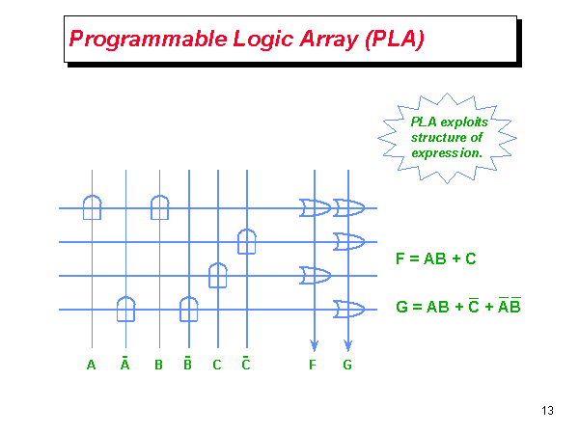

Slide 35
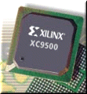
Programmable Logic Device
Programmable Logic Device
Programmable Logic Array, Programmable Array Logic, Field Programmable Gate Array
All layers already exist
Designers can purchase an IC
To implement desired functionality
Connections on the IC are either created or destroyed to implement
Benefits
Very low NRE costs
Great time to market
Drawback
High unit cost, bad for large volume
Power
Except special PLA
slower
1600 usable gate, 7.5 ns
$7 list price

Slide 36
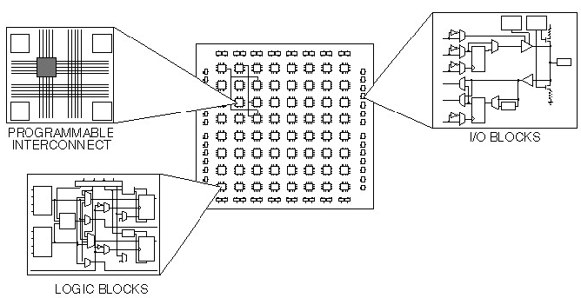
Xilinx FPGA

